Slide 1

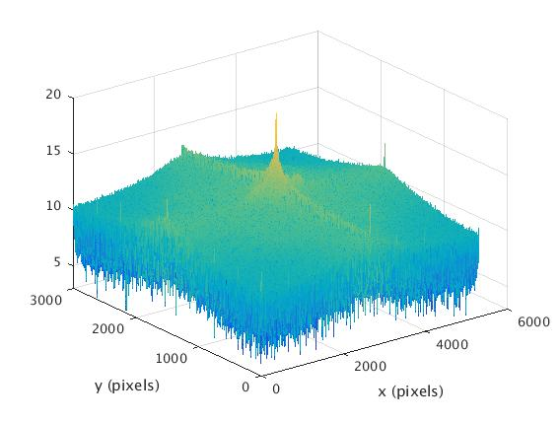
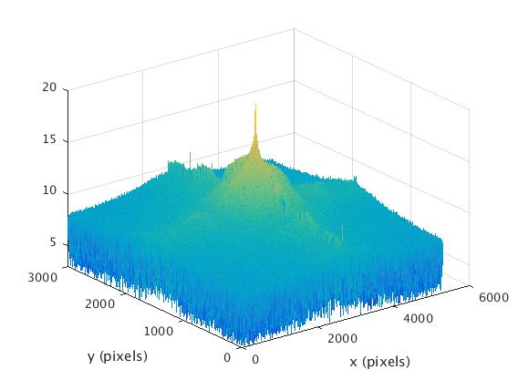
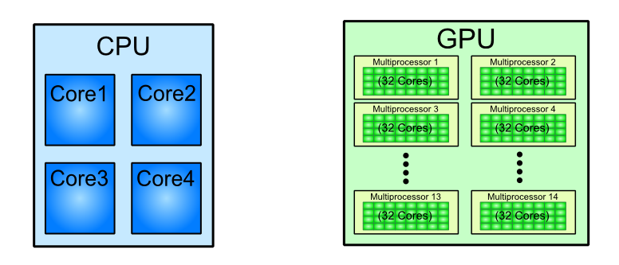
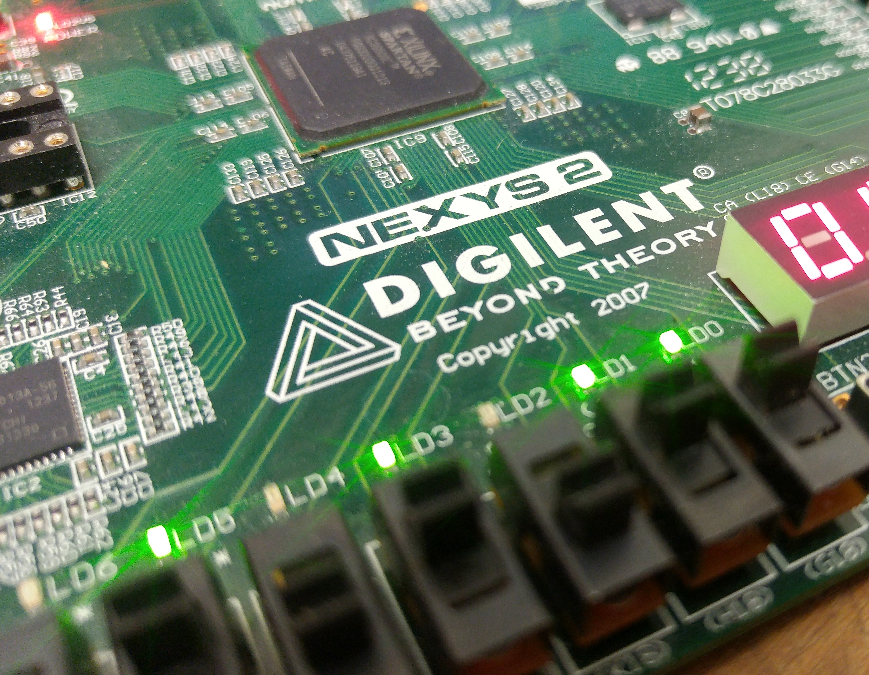
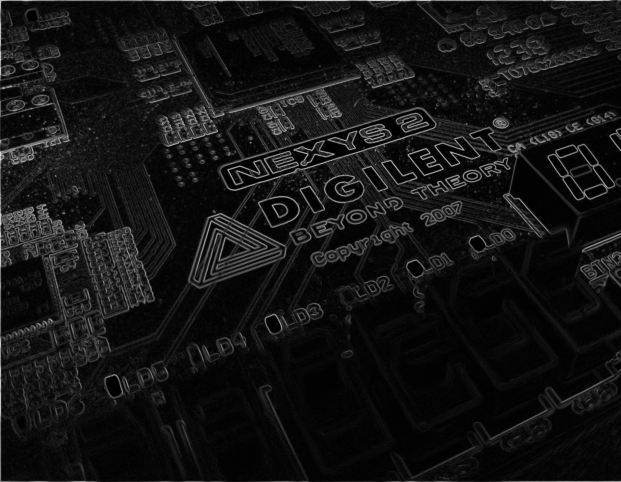
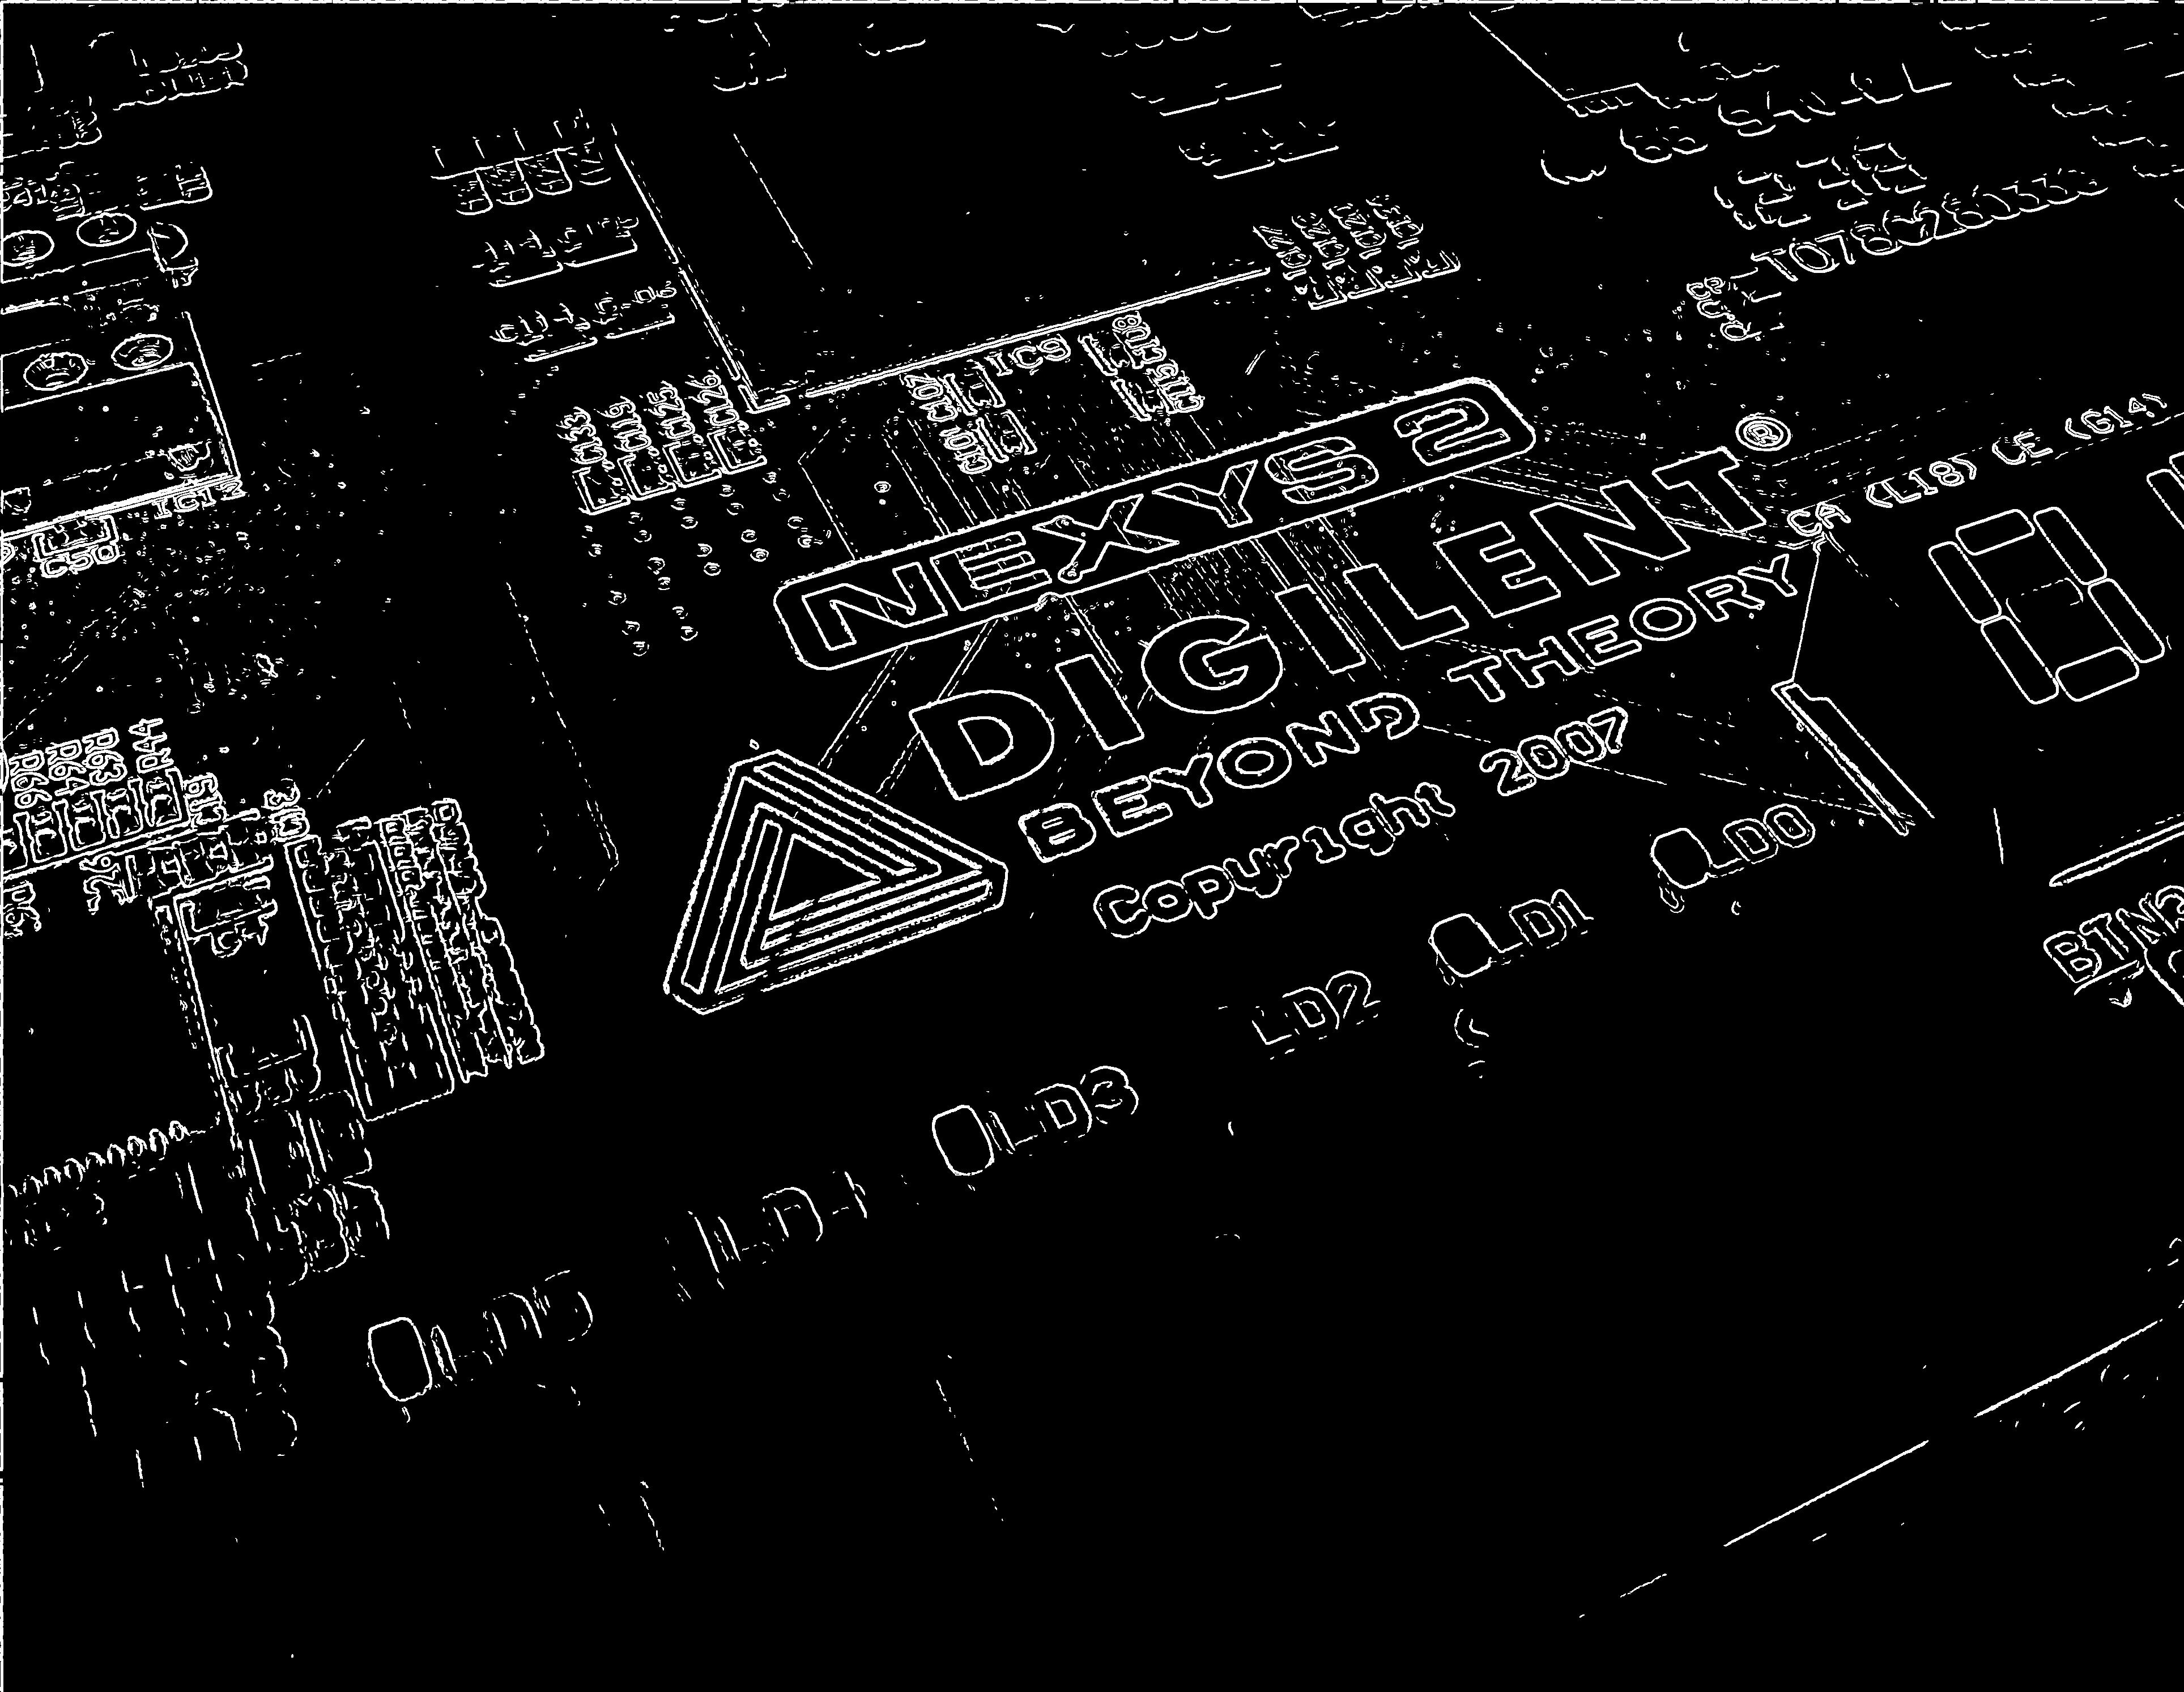
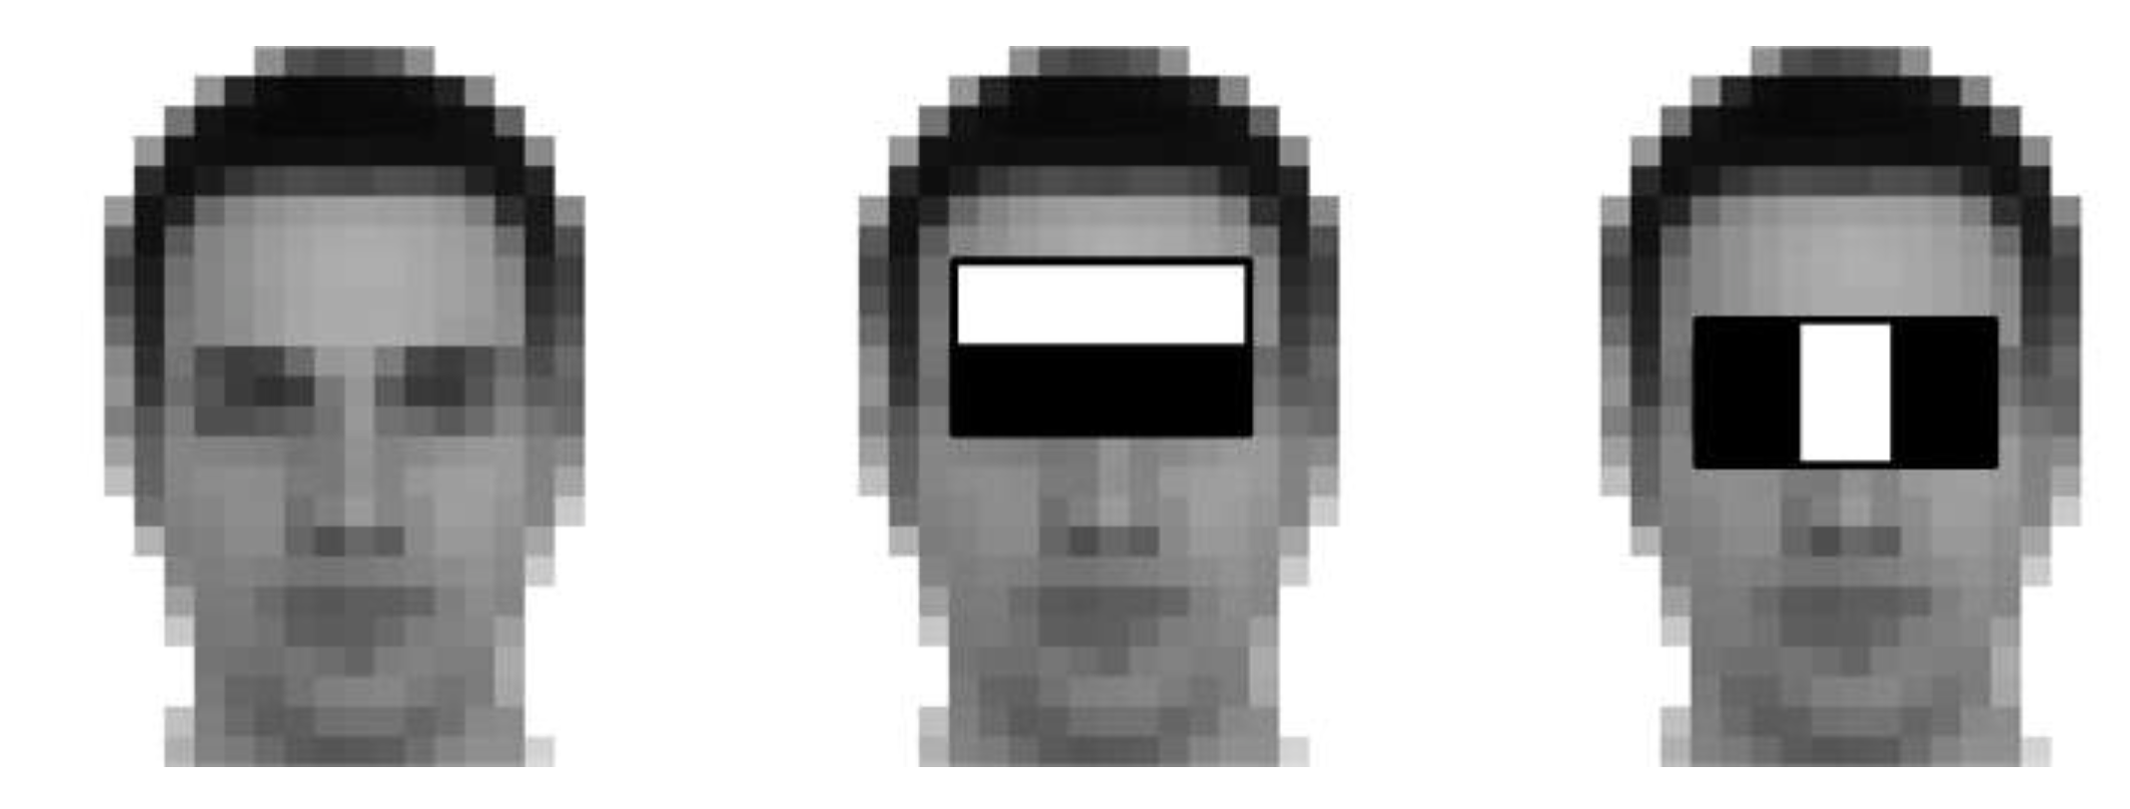
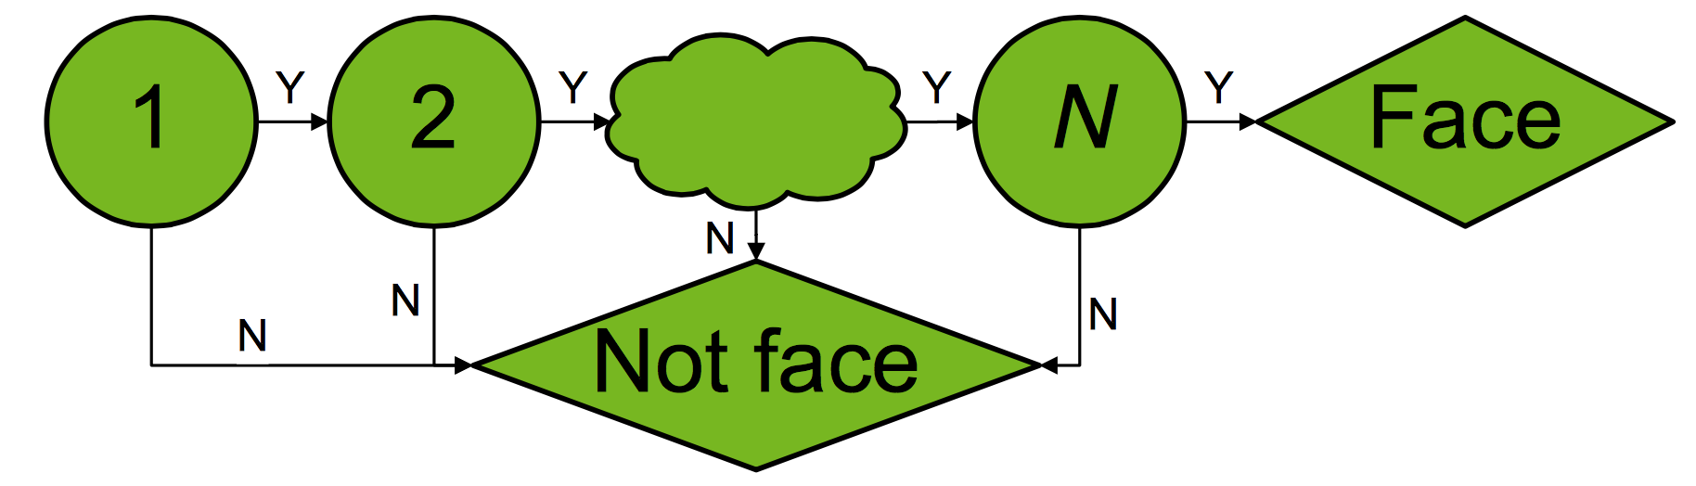
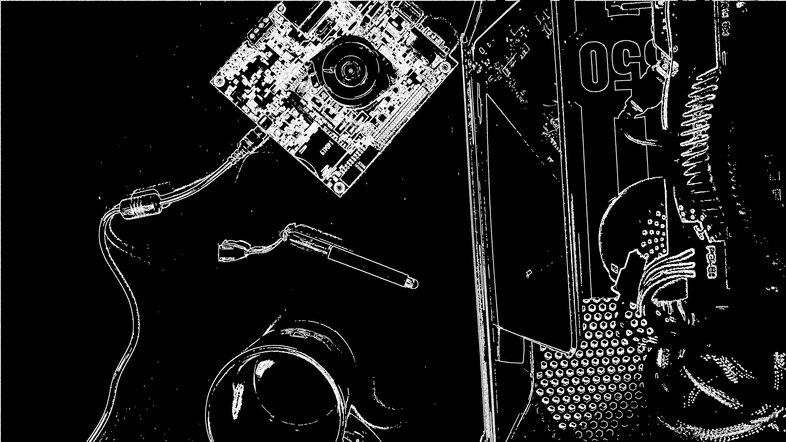

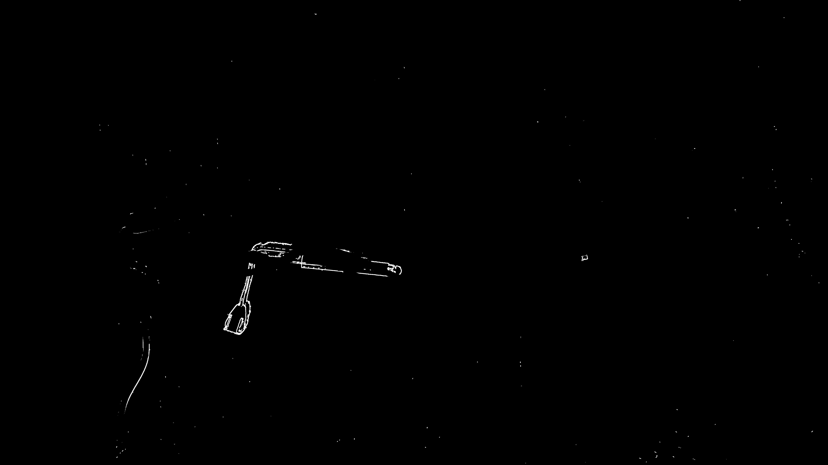
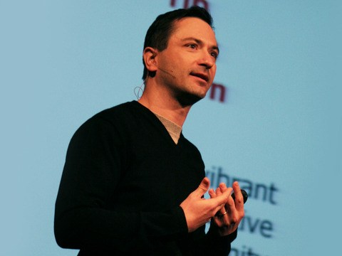
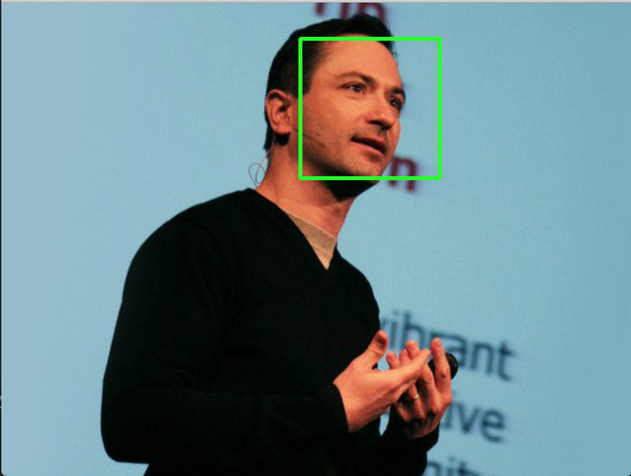
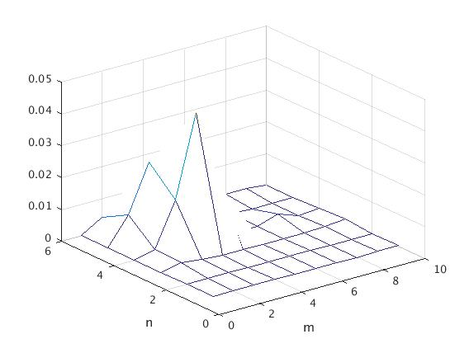

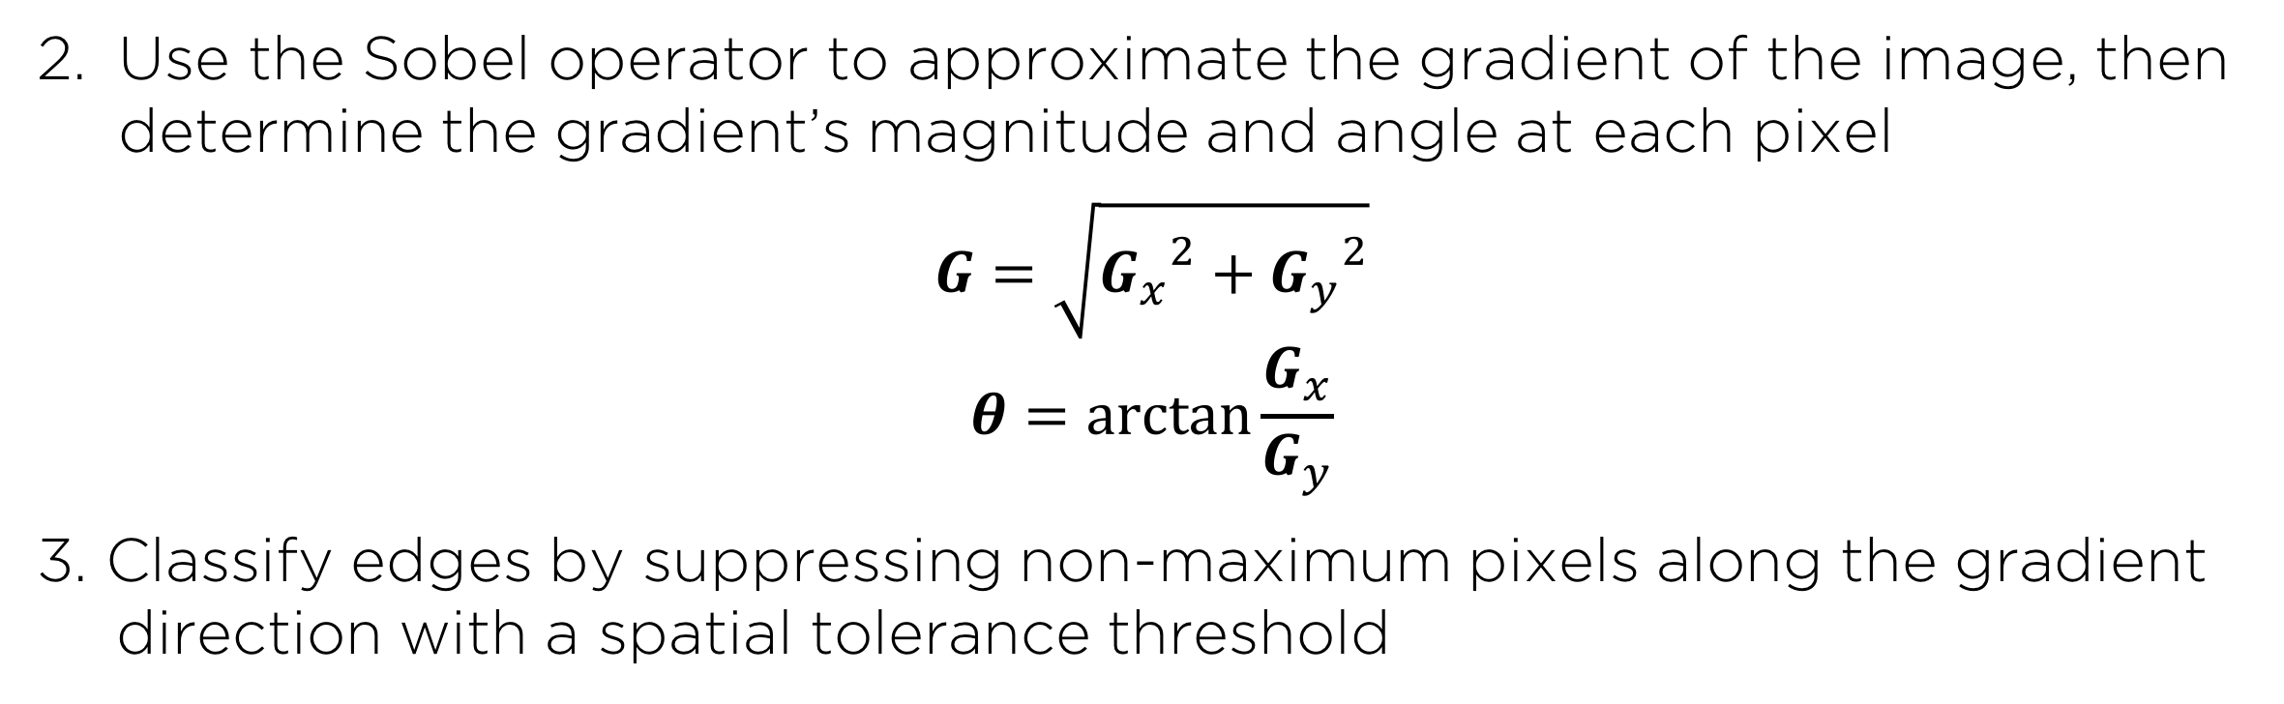
GPU-Accelerated Parallelization of
Common Computer Vision Applications
Emilio Del Vecchio, Kevin Lin, Senthil S. Natarajan
Department of Electrical and Computer Engineering, Rice University
I. INTRODUCTION
III. EDGE DETECTION
V. GPU SPEEDUP RESULTS
-Graphics Processing Units (GPU’s) have recently become popular for their ability to parallelize computations and achieve much greater efficiency as compared to the serial implementation of a CPU.
Reduce high frequency noise from the image with a Gaussian blur
-The NVIDIA CUDA framework was used to run the parallel implementations of our algorithms.
-The results below were obtained on a Intel Core i7 4790K @ 4.7 GHz (4C, 8T) CPU and an NVIDIA GeForce GTX 750 (512 CUDA cores, 1653
MHz core clock, 6510 MHz memory clock, 2 GB video memory) GPU.
VS
Fig 1. The GPU’s parallel architecture allows it to parallelize massive computations.
Fig 5. FFT of grayscale noisy image, unfiltered (left) versus filtered (right)
Use the Sobel operator to approximate the gradient of the image, then determine the gradient’s magnitude and angle at each pixel
$$G=\sqrt{{G_{x}}^{2}+{G_{y}}^{2}}$$
$$θ=\arctan{\frac{G_{x}}{G_{y}}}$$
3. Classify edges by suppressing non-maximum pixels along the gradient direction with a spatial tolerance threshold
-Our objective: utilize the GPU’s ability to accelerate computer vision applications like facial recognition, edge detection, and motion tracking.
-Due to the proliferation of computer vision in many regular tasks, this affords us an opportunity to explore how to make such common algorithms more efficient.
II. FACIAL RECOGNITION
Extract HAAR features of a face from a set of positive and negative training images.
Fig 6. Original image (left), Sobel filter output (center), final edges (right)
Fig 2. Example HAAR features of a random face
IV. MOTION DETECTION
VI. CONCLUSIONS
2. Use Adaptive Boosting machine learning to train a multi-stage, or cascade, classifier, against positive and negative HAAR features.
Calculate a pixel-by-pixel difference map from the edges of two frames, applying movement tolerance thresholding in the process
-Overall, the CUDA implementations of the computer vision algorithms demonstrated that GPUs offer a powerful solution to the rising data requirements of modern computational and signal processing problems.
-When the total computations required are minimal (like processing on a 100x100 pixel image), the CPU is a better alternative. But for large computations, the GPU’s parallelization ability offers a great boost in run time.
-Potential limitations include: CUDA memory optimization, usage of 3rd party libraries, and performance of specified GPU vs. other high end GPUs.
Fig 3. Cascade Classifier training rejects most non-face regions early.
Fig 7. Two sequential frames in a video stream and the detected difference between them
3. Apply final cascade classifier to a loaded image. The OpenCV library provides modules to encapsulate this process.
Estimate the motion region from a difference density map
VII. ACKNOWLEDGEMENTS
Fig 4. Original sample image (left), detected faces (right)
Fig 8. Spatial density map (left), motion area estimation (right)
-We would like to thank CJ Barberan and Richard Baraniuk for their guidance and support in this project.

